Slide 1


Online Banking System
IGATE is now a part of Capgemini

Slide 2
TEAM MEMBERS
R . SARULATHA (150943)
JAHNAVI KANTHAMNENI (150763)
KUNCHA SWATHI (150782)
UDDARAJU GEETHIKA (150757)
VANDANAPU BHAVYA (150760)

Slide 3
CONTENTS
OVERVIEW
ACTORS
TESTCASE
REQUIREMENT ITEMIZATION
USECASE
DEFECTS
APPLICATION LINK
TEST CASE ADEQUACY
TEST CASE EFFECTIVENESS
PROJECT STATISTICS
TRACEABALITY MATRIX

Slide 4
OVERVIEW OF THE PROJECT
This project is aimed at developing an online Banking System (OBS) for Account holders and Bank admin. Online Banking allows account holders to view mini/detailed statements and do fund transfer. It allows the bank admin to create account and view all transactions on a secure website.

Slide 5
ACTORS
Admin
User

Slide 6
TEST CASES
Test case is the smallest unit of the testing plan.
Test case gives description of necessary actions and parameters to achieve and verify the expected behavior of a particular function or the part of the tested software.
A test case is a set of conditions or variables under which a tester will determine whether a system under test satisfies requirements or works correctly.
The process of developing test cases can also help find problems in the requirements or design of an application.

Slide 7
Link :Project_TestCase_Online.xlsx
TEST CASES
LOGIN
User
Request to add personal details
View mini statement
Request for Check book
Fund Transfer
Track Service Request
Admin
Create new account
View overall transactions

Slide 8
REQUIREMENT ITEMIZATION
Requirements validation is an iterative process which takes place throughout the lifecycle of the project.
During elicitation, analysis and specification you should constantly be questioning and clarifying the data given to you in order to check its validity.
This will ensure that the SRS that you produce is complete, consistent and ready for the formal validation process.
LINK: RVFD for online banking_project.xlsx

Slide 9
Requirements Validation And Functional Decomposition
Termination
End process
File Handling
Storage of information
Invocation
Start process
Implicit
Efficiency
RVFD
System
Minimum specifications
Explicit
User specified
Query
improvements
Error Handling
consistency
Security
For confidentiality

Slide 10
USE CASES
A use case is a written description of how users will perform tasks on website.
A use case is a methodology used in system analysis to identify, clarify, and organize system requirements.
The use case is made up of a set of possible sequences of interactions between systems and users in a particular environment and related to a particular goal.
A use case can be thought of as a collection of possible scenarios related to a particular goal, indeed, the use case and goal are sometimes considered to be synonymous.
LINK:USECASE_OnlineBanking.docx

Slide 11
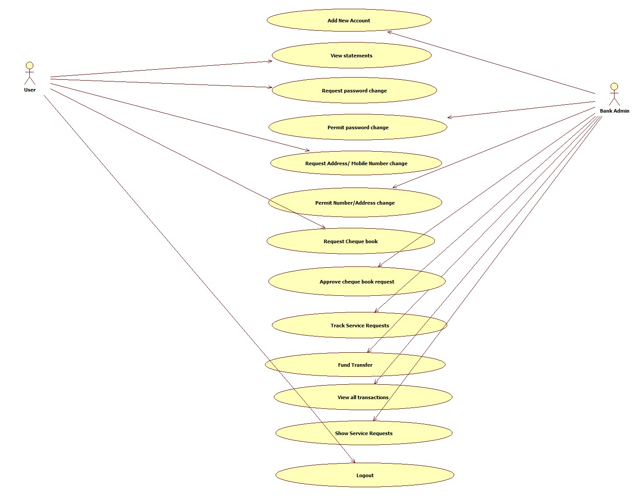
USE CASES

Slide 12
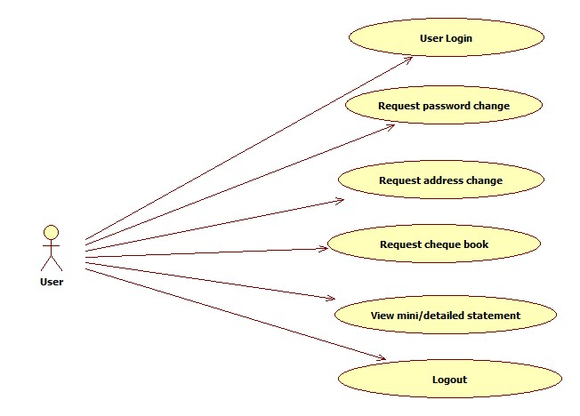
USE CASE DIAGRAM – USER

Slide 13
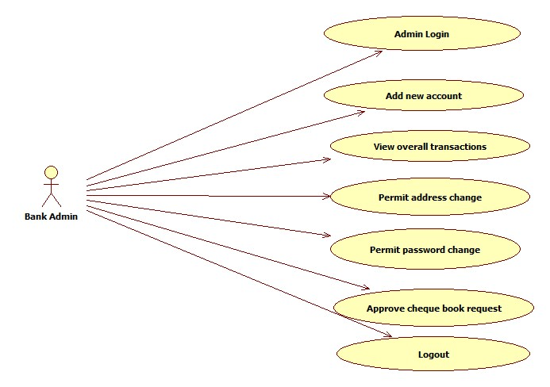
USE CASE DIAGRAM - ADMIN

Slide 14
USE CASE HYPERLINKS
Login:
Admin Login
User Login
Functionalities:
Manager Create account
Manager View all transactions
User View mini/detailed statement
User Request add details
User Request Check book
User track service request
User fund transfer

Slide 15
DFDR
A defect is an error or a bug, in the application that causes it to produce an incorrect or unexpected results.
A programmer while designing and building the software can make mistake or error.
These mistakes or errors mean that there are flaws in the software, these are called defects and the report written for logging these defects is called a defect report.
LINK: DefectReport_OnlineBanking.xlsx

Slide 16
DEFECTS FOUND
Admin
Even after entering the invalid user id and password for more than three times the account is not locked.
The account holder name in the registration page is accepting numerical characters.
The account type is not checked.
Pan doesn’t validate and accepts symbols.
The account holder is not able to scroll the select bar.
The opening balance field is not mandatory and it can be left empty.
Secret question is not validated and asks for answer in mandatory.

Slide 17
DEFECTS FOUND
The account holder is not able to scroll the select bar for selecting select question.
The account holder is not able to view the transactions by click view Transactions.
The Mini/Detailed statements are not present in account holder page.
The registration page is showing the pan card is already existing for every new account.
The pan card is validating when it left with blank.
User

Slide 18
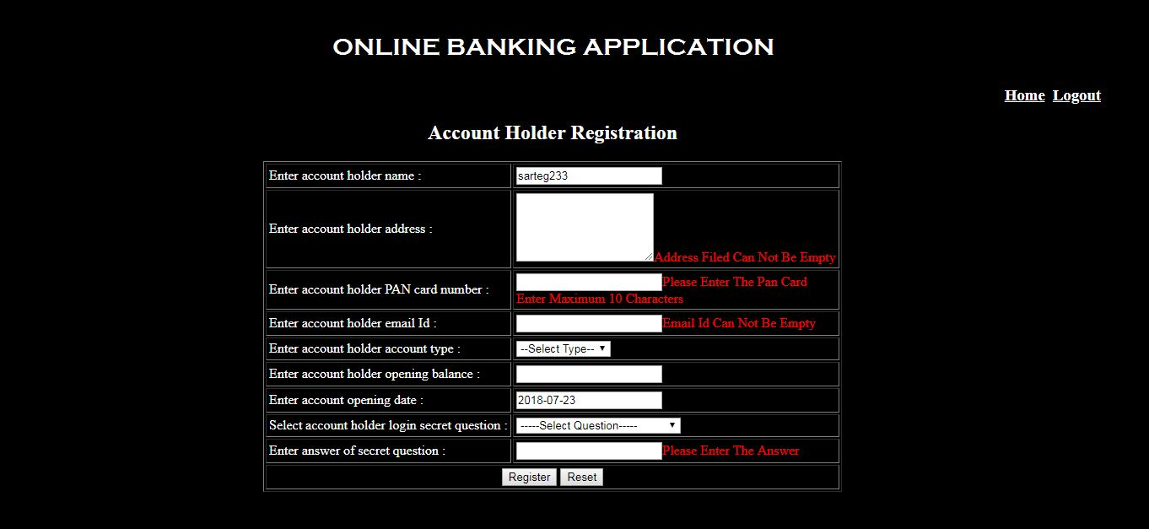
Defect snapshots: User Name

Slide 19
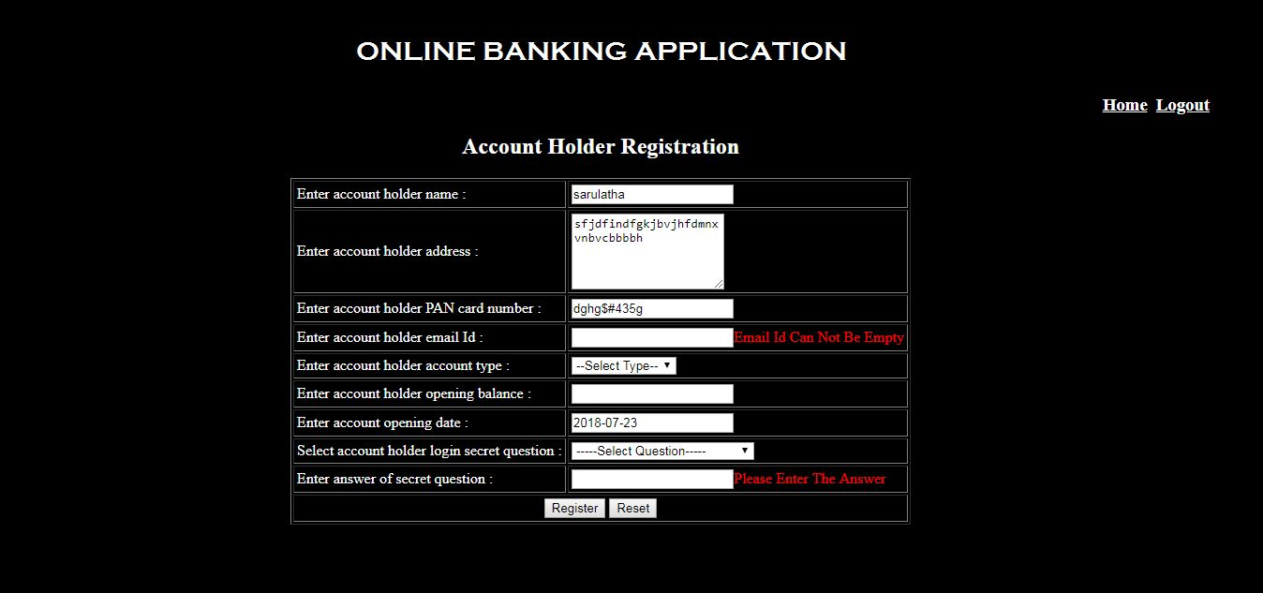
Contd. PAN Defect

Slide 20
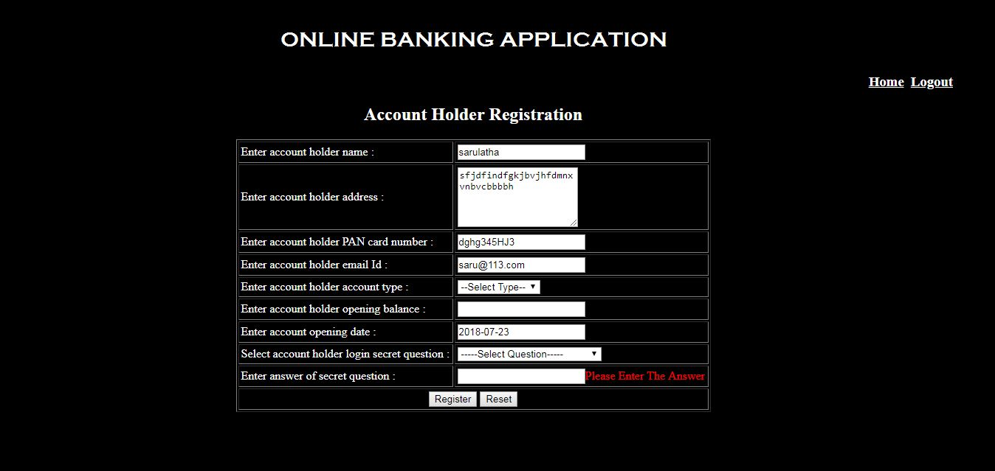
Contd. Email Defect

Slide 21
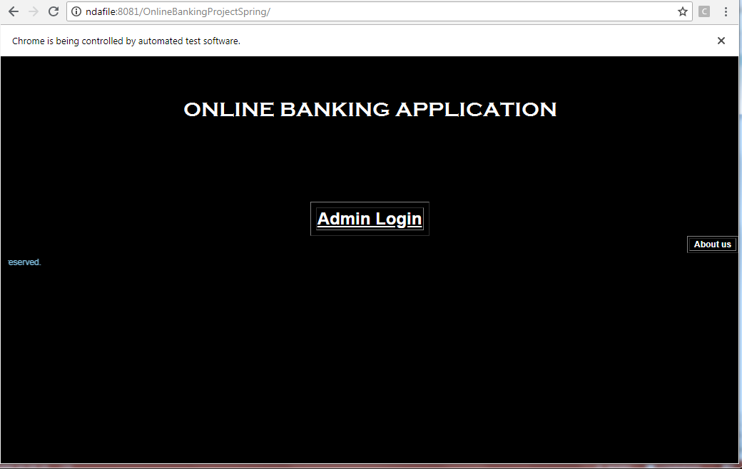
Application link
http://ndafile:8081/OnlineBankingProjectSpring/

Slide 22
Test Case Adequacy
This defines the number of actual test cases created vs estimated test cases at the end of test case preparation phase. It is calculated as
Test Case Adequacy = No. of actual Test cases*100/No. of estimated Test cases estimated
=(93*100)/200
=68

Slide 23
Test Case Effectiveness
This metrics defines the effectiveness of the test cases which is measured in terms of the number of defects found in testing with using the test cases.
Test Case Effectiveness = No. of defects detected using test cases*100)/total no of defects detected in testing
=(49*100)/70
=70

Slide 24
Project Statistics
Number of Test Cases = 93
Number of Test Cases Passed = 32
Number of Test Cases Failed = 61
Number of Defects Logged = 13
Number of Use Cases = 9

Slide 25
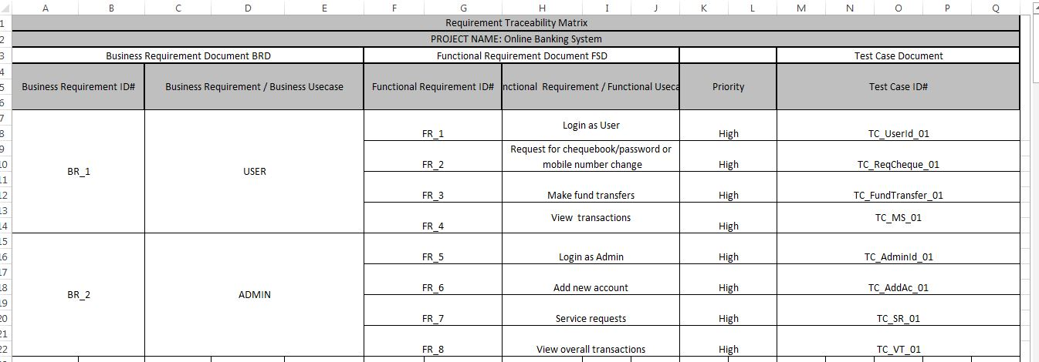
Traceability Matrix

Slide 26
THANK YOU

